Slide 1

healthchain
JADHAV SHIVANI 15/12/2022
FIND YOUR WAY TO BETTER DIGITAL HEALTH

Slide 2
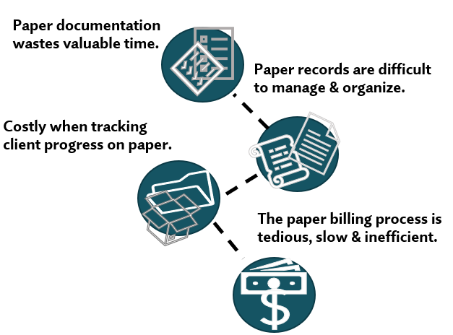







Problem
Paper wastage
Data Security & Privacy Threats
Interoperability /consumer data access
issues arises
Security and privacy of medical data are some of the most challenging issues.
No direct access to your health records

Slide 3
Solution
Electronic Health Records (HealthChain)are the Solution to improving the overall healthcare system.
Blockchain-based EHRs and the ability to exchange health information electronically can help you provide higher quality and safer care for patients while creating tangible enhancements for your organization.

Slide 4
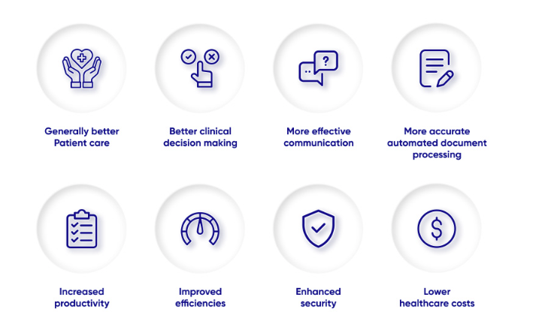
benefits
Reaching quality improvements would not be possible without an EHR.

Slide 5

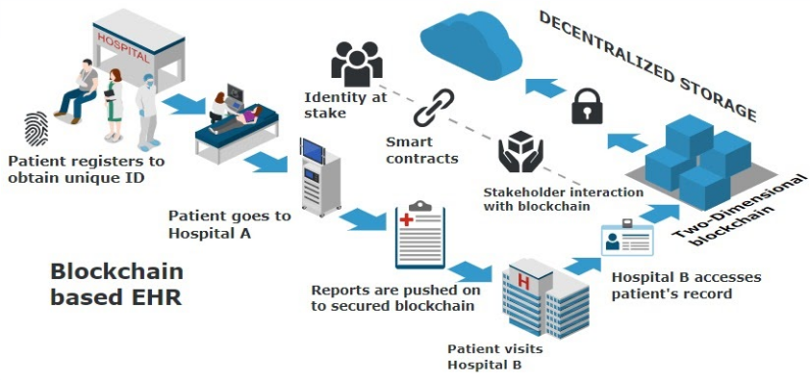
Product Overview

Slide 6

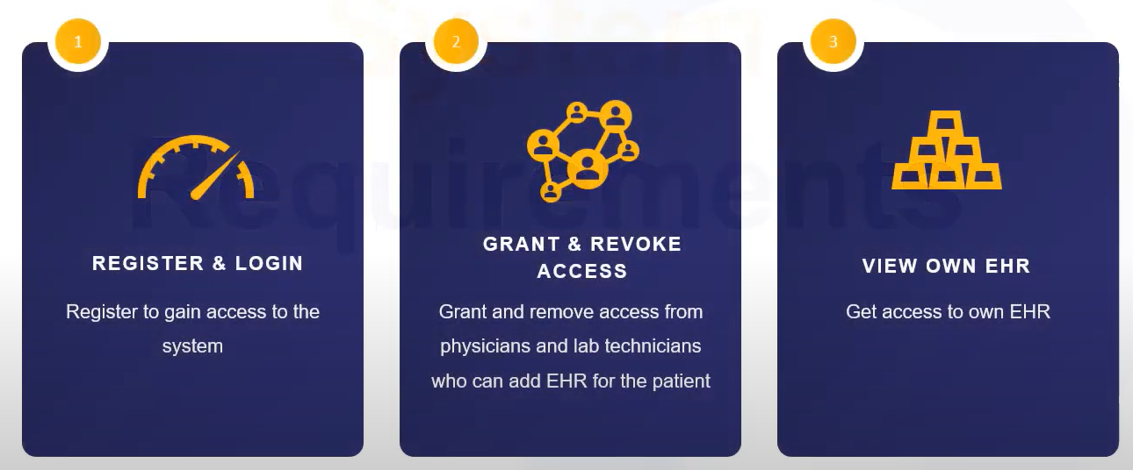
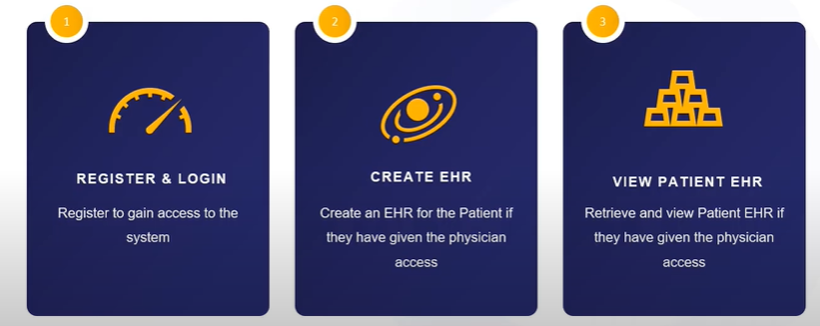
Requirements
Patient Requirements
Physician Requirements
7

Slide 7

Company overview

Slide 8
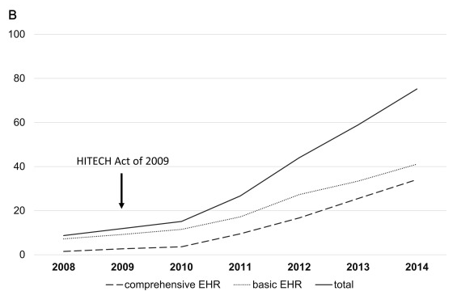
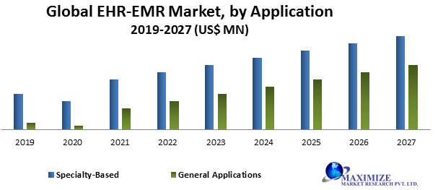
Market overview
78%Physicians offices used EHR in 2012​
57% Said that they have enjoyed the returns from their EHR investment
59% Said that EHR has improved their practices and workflow.

Slide 9

Revenue model
Membership Fees
Modification Fees for every Organization.
Government Incentives
Collaboration with health Applications
Collaboration with pharmacies
Sell Advertisement

Slide 10

Our competition
HEALTCHAIN
Competitors​
Our system is based on blockchain so security won be an issue.
Pricing is appropriate so the patient and hospital from every class can afford it.
There is only one EHRs company in South Korea called ezCareTech.
It is not a blockchain-based system so security may be an issue.
Slightly more expensive than our company

Slide 11






The full team
Shivani
JOhn​​
kris​​
lia​​
President​
Chief Executive Officer​
Application Analyst
Physician Advocate
Palistha
mark​
Aiman
Robin
Project Manager
SEO Strategist​
Product Designer​
Content Developer​

Slide 12
THANK YOU

